Slide 1
TU856-1 and TU858-1 Computer Architecture and Technology
Online Only
(Week 9) Tutorial 5

Slide 2
Von Neumann Architecture
Q: Why does the von Neumann architecture endure?
A: Apart from the fact that hardware has been incrementally improved but its modality has remained in relation to the form of ‘processor’, the general ‘computer system’ needs ORDER and PRECISION, and the von Neumann architecture provides that.

Slide 3
Von Neumann Model

Slide 4
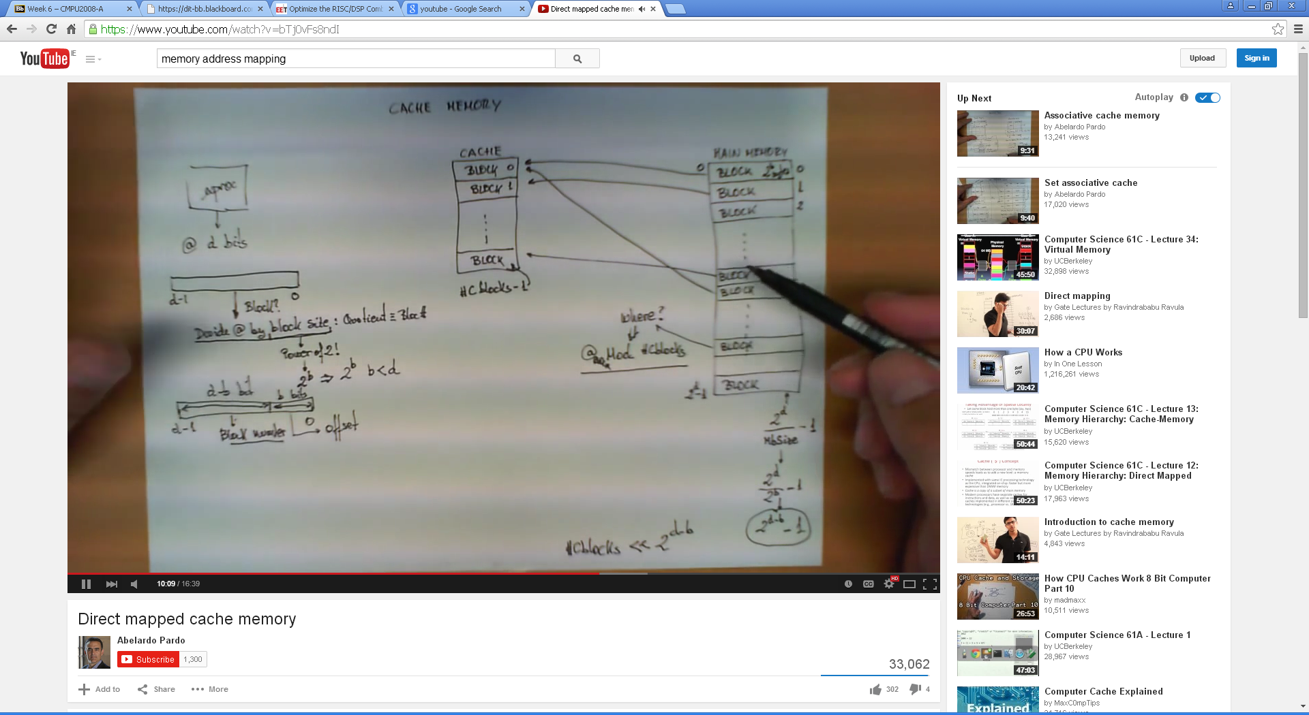
Memory Addressing Example
Here is that Youtube clip on Memory Addressing again!
https://www.youtube.com/watch?v=bTj0vFs8ndI

Slide 5
The Instruction
The instruction is the fundamental unit of work in a computer.
An instruction specifies two things:
opcode: the operation to be performed
operands: the data/locations to be used for operation
An instruction is encoded as a sequence of bits, just like data!
Often, but not always, instructions have a fixed length, such as 16 or 32 bits.
The Control Unit interprets the instruction: generates a sequence of control signals to carry out the operation.
The operation is either executed completely, or not at all.
A computer’s instructions and their formats is known as its Instruction Set Architecture (ISA).

Slide 6
Instructions and the Clock
The clock signal that keeps the control unit moving.
At each clock “tick” the control unit moves to the next machine cycle – which may be next instruction or next phase of current instruction.
Clock generator circuit:
Based on crystal oscillator
Generates regular sequence of “0” and “1” logic levels
Clock cycle (or machine cycle) - rising edge to rising edge
“1”
“0”
Machine
Cycle
time→

Slide 7
Typical Exam (Sub) Question For This Content
Question
What are the principles of von Neumann Architecture and what are the functional sub-components of that architecture?
Sample solution
The von Neumann architecture is a computer design model that uses a single storage structure to hold both instructions and data.
The term describes such a computer, which implements a Universal Turing machine, and the common "referential model" of specifying sequential architectures, in contrast with parallel architectures.
The separation of storage from the processing unit is implicit in the von Neumann architecture.

Slide 8
Solution continued
The term "stored-program computer" is generally used to mean a computer of this design.
Von Neumann begins his idea with a broad description of the general-purpose computing machine containing four main ‘sub-components’. These are identified as relating to arithmetic, memory, control, and connection with the human operator: - the arithmetic logic unit, the control unit, the memory, and the input-output devices of the classical computer model.
To von Neumann the key to building a general purpose device was in its ability to store not only its data and the intermediate results of computation, but also to store the instructions, or orders that brought about the computation.
In a special purpose machine, the computational procedure could be part of the hardware. In a general purpose one the instructions must be as changeable as the numbers they acted upon.
8
(10 marks)

